Slide 1
Feature extraction for audio
Intermediate seminar presentation (AML-R)
Marcus Cramer

Slide 2
Agenda
Data understanding
Data cleaning
Machine learning approaches
Results

Slide 3

The available train dataset is huge; and the test set is just as big
1,932 features (completely anonymized)
Numerics
Strings
Binary target
145,231 obeservations
Factors
NAs
Dates
The immense size of the dataset and the variety of anonymized features makes qualitative analysis impossible.

Slide 4







Different attribute types must be handled seperately
SOURCE
Business Understanding
Data Understanding
DATA
Data Cleaning
Deployment
Modeling
Evaluation

Slide 5
Different attribute types must be handled seperately
Business Understanding
Data Understanding
DATA
Data Cleaning
Deployment
Modeling
Evaluation

Slide 6
Different attribute types must be handled seperately
No of categoricals update
Number of attributes per attribute type

Slide 7
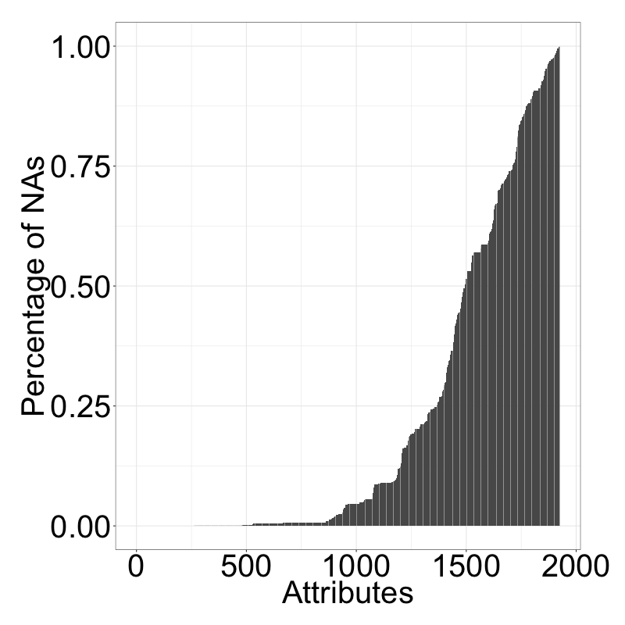
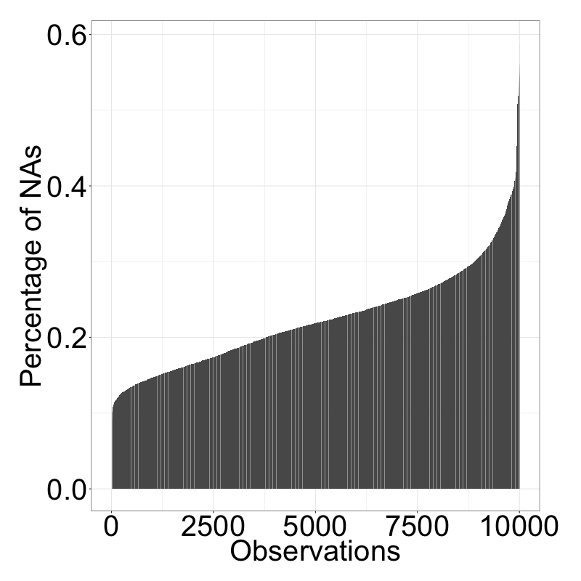
Number of Nas varies a lot per attribute and observation
X axis
NA values per attribute in %
NA values per sample in %

Slide 8
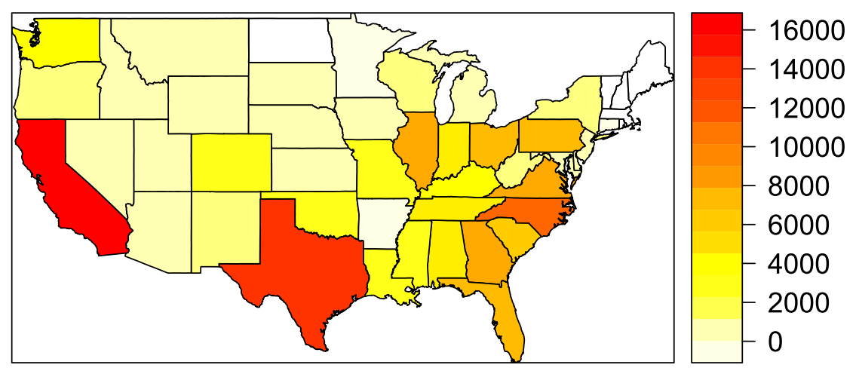
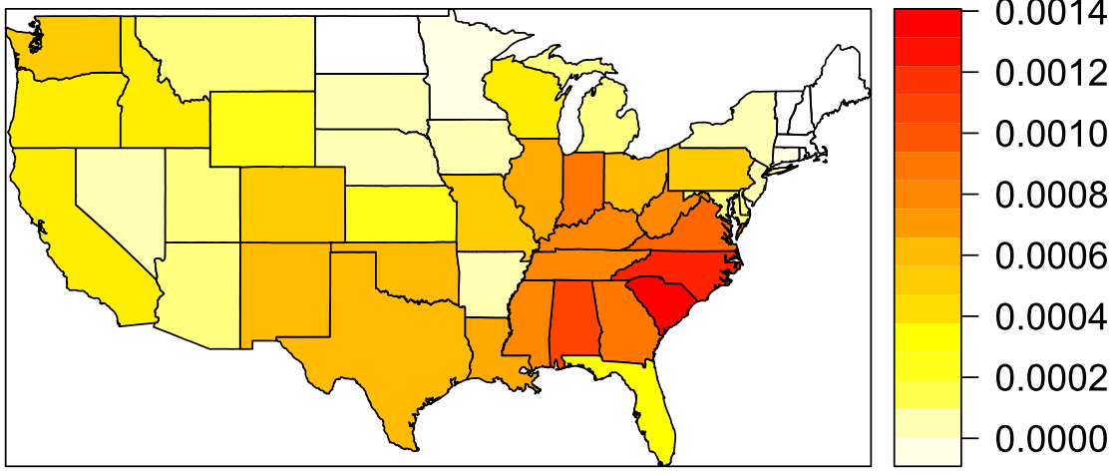
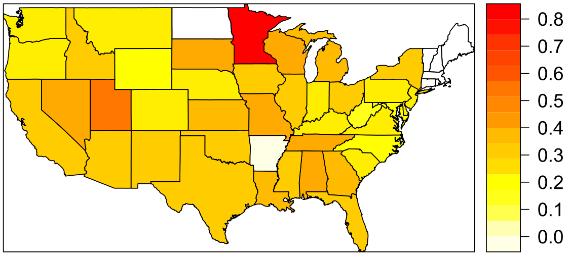
Numbers vary drastically among us states
Occurrences of US states
Occurrences w.r.t population
Target response rate

Slide 9
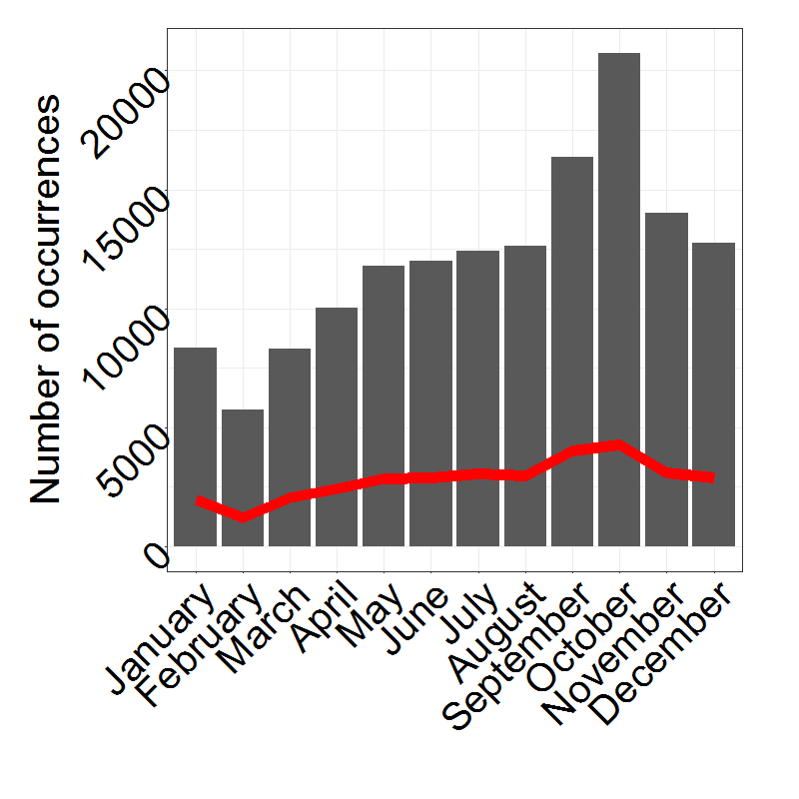
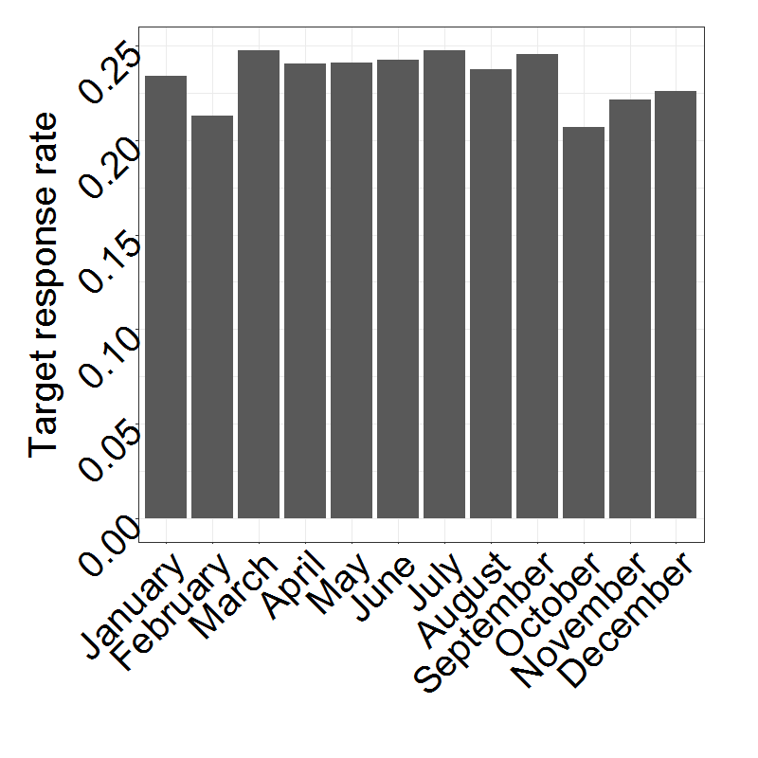
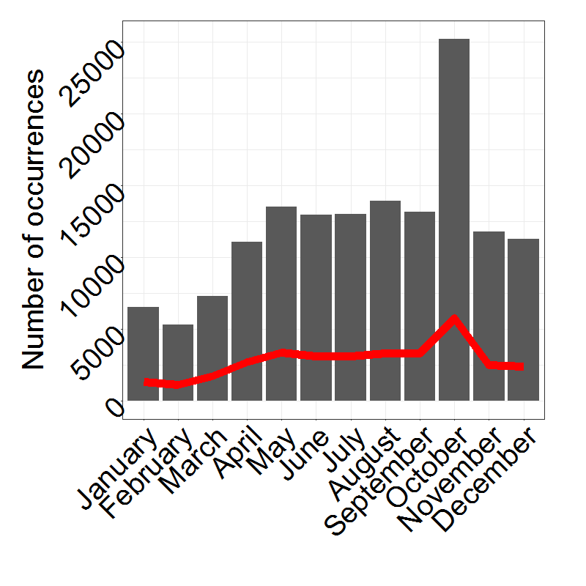
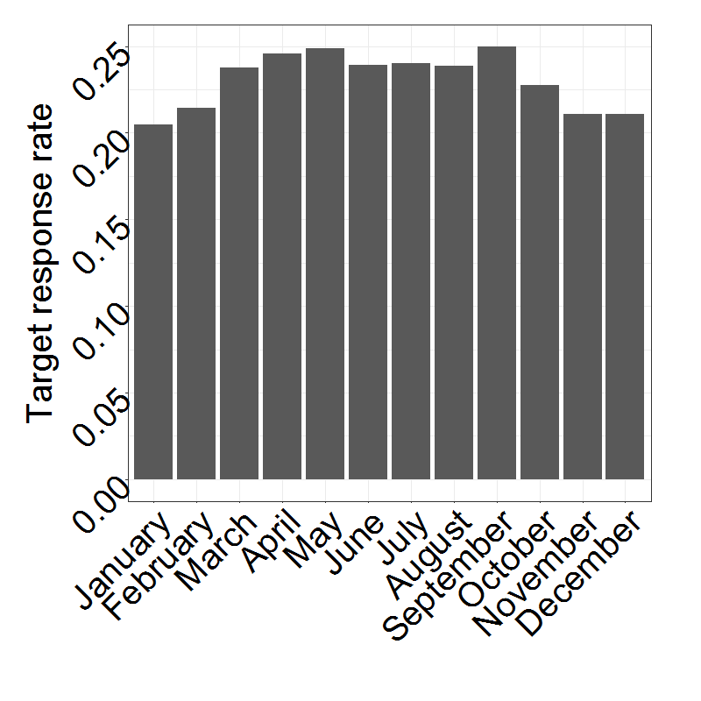
Numbers vary drastically For different months
Occurrences of months (2/16 features)
Target response rate of months

Slide 10
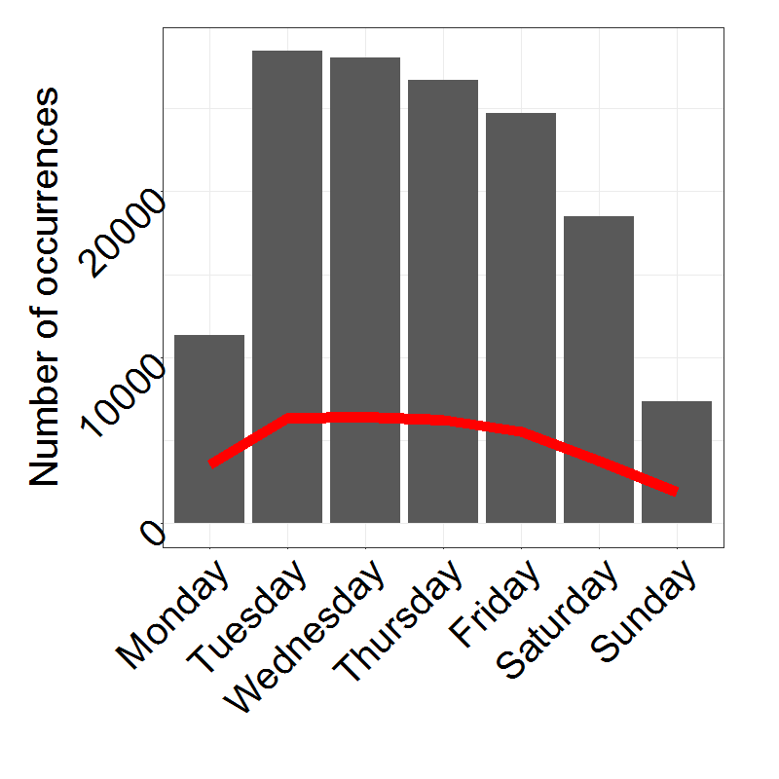
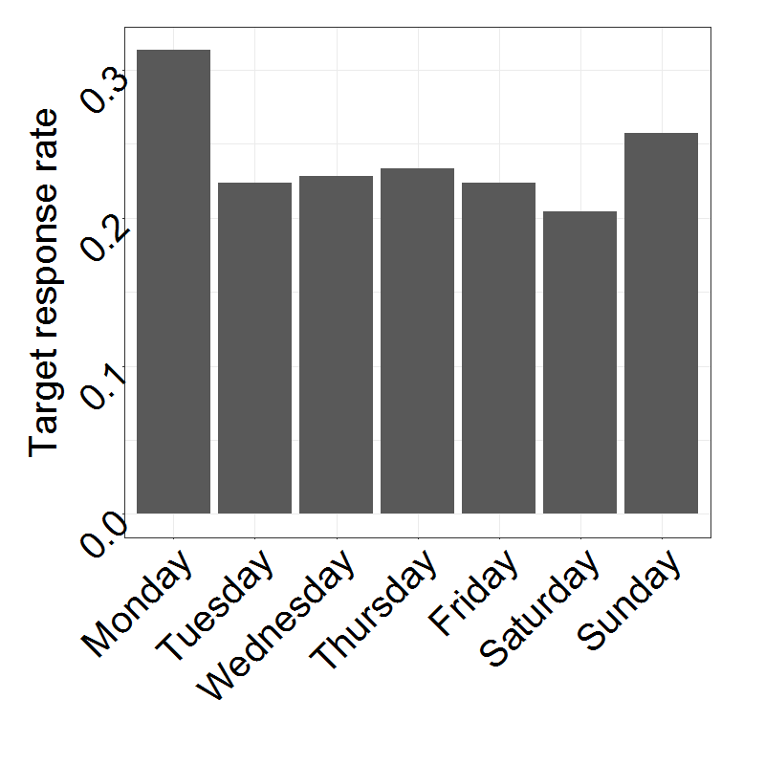
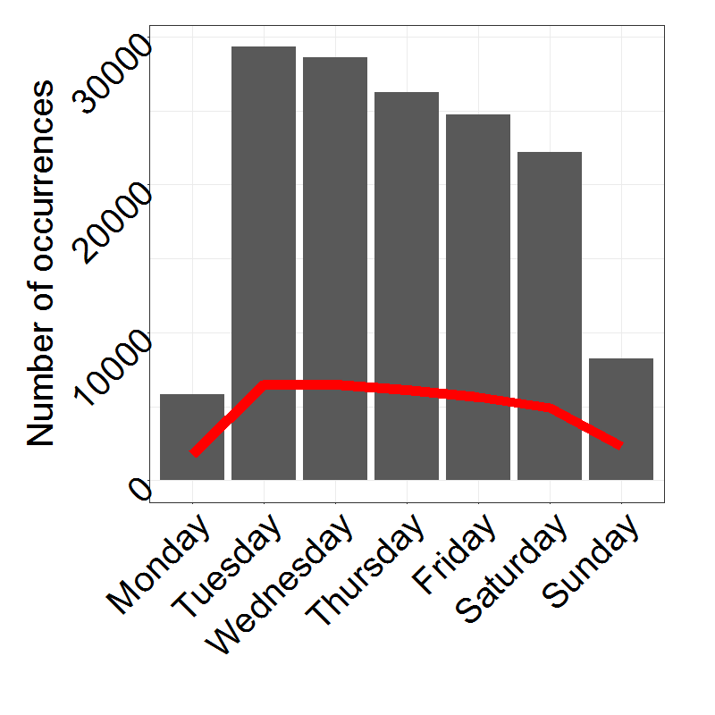
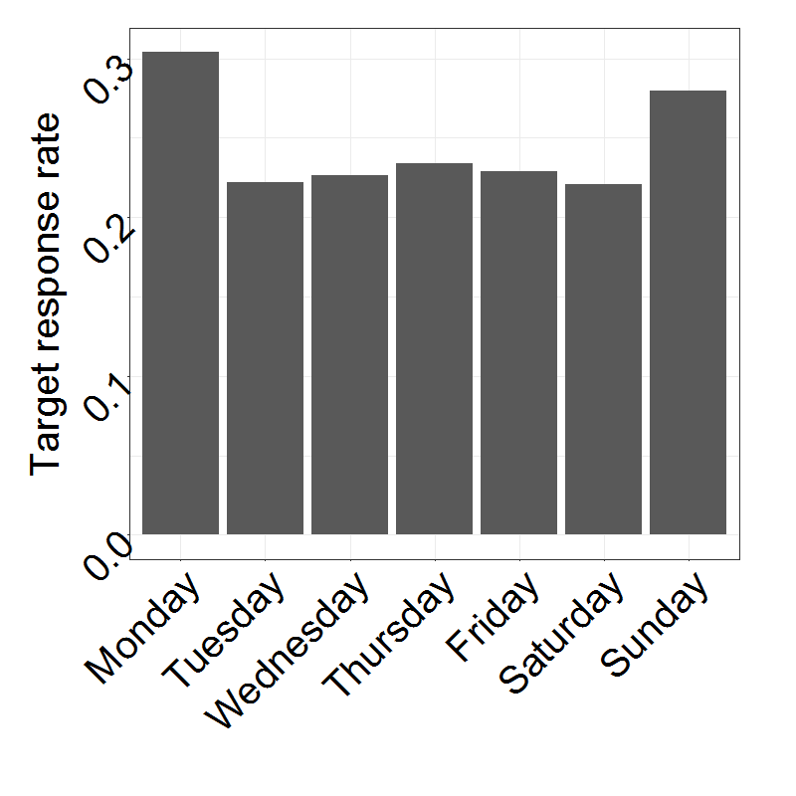
Numbers vary drastically FOR different Days
Occurrences of days (2/16 features)
Target response rate of days

Slide 11
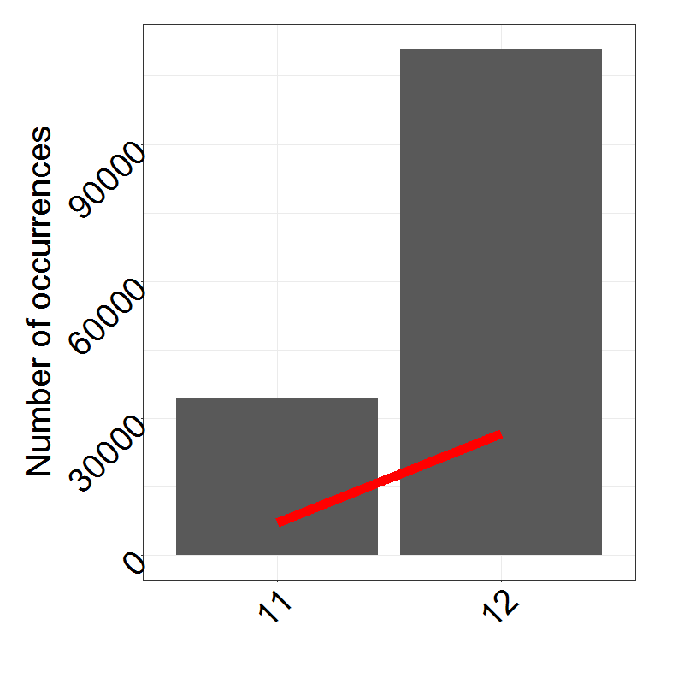
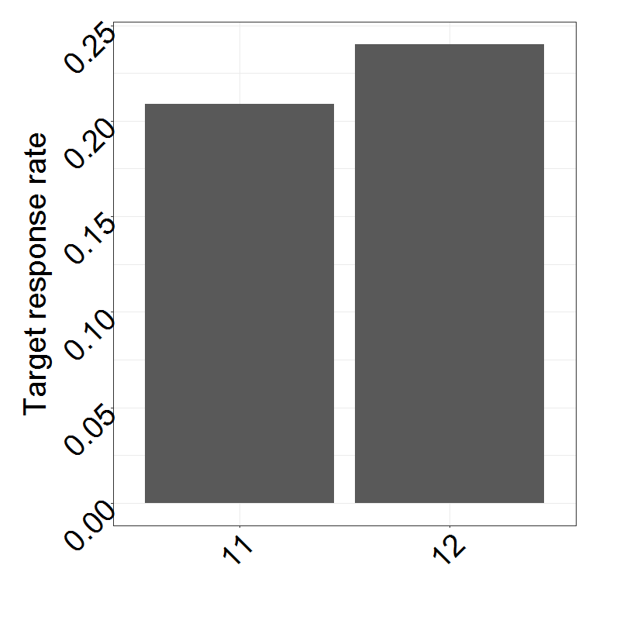
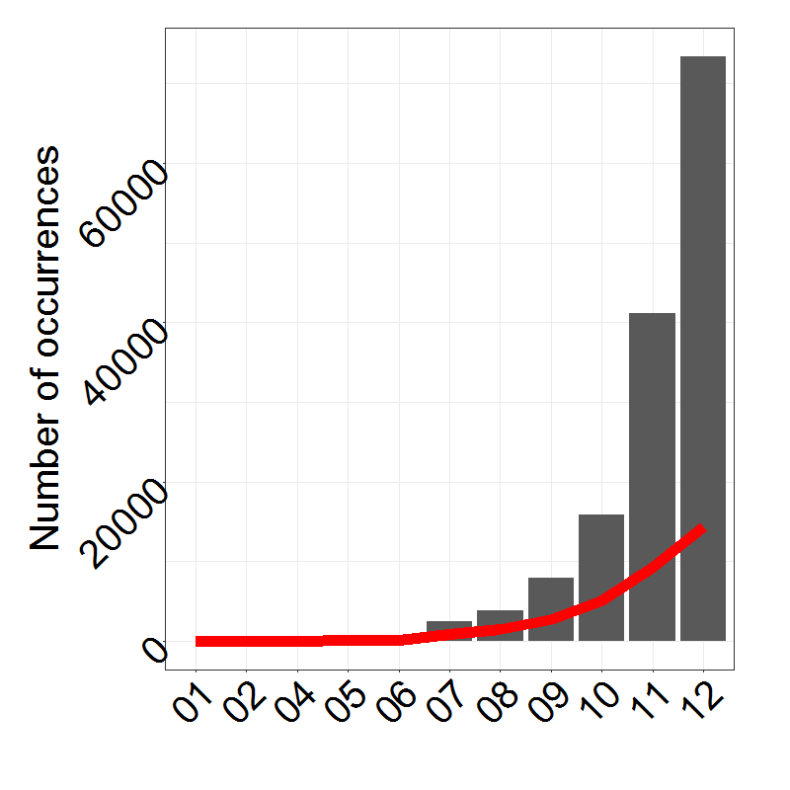
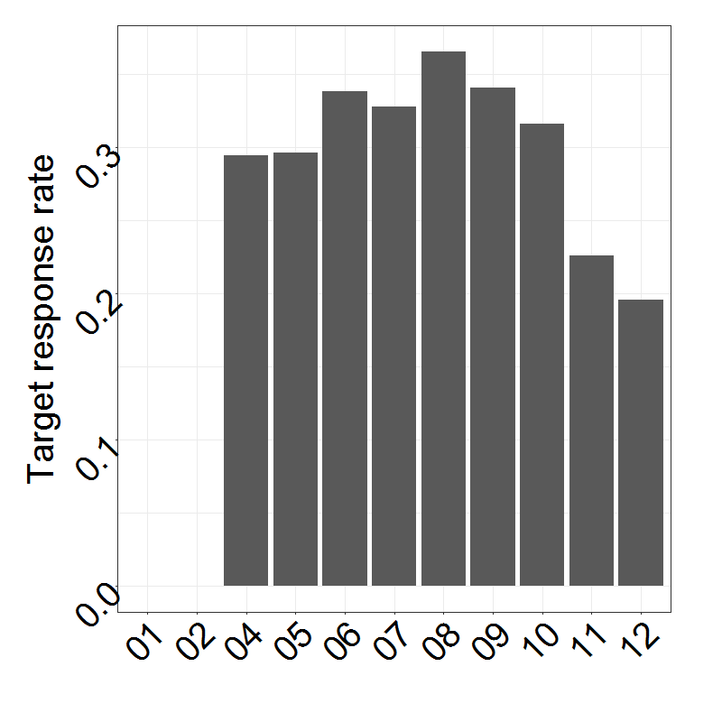
Numbers vary drastically FOR different Years
Occurrences of years (2/16 features)
Target response rate of years

Slide 12
Agenda
Data understanding
Data cleaning
Machine learning approaches
Results

Slide 13
Beautify
Different NA encodings
Obvious NAs: -1 (all other values positive), [], blank
More sophisticated:
Find columns with negative mean of unique values and remove outliers -> results in positive mean of unique values -> outlier = -99999 -> NA encoding
Take mean of unique values and mean of unique values minus one extremum on both sides -> if first value is more than 10 times higher than second value, we probably have an illogically high maximum value -> this is the case for 1+e09, 9999, 99, 100
Sometimes, the second highest value also seems to be some sort of NA encoding (same approach as above but removed second maximum too) -> 9996, 9998, 98
For other columns, a couple of extreme outliers exist. The maximum of extreme outliers is 5 values, which are more than 10000 times higher than the rest in the same column -> 999999999, 999999998, 999999997, 999999996, 999999995, 999999994
Everything double checked for plausibility with random manual samples
Made sure that data is unlikely to be factors (then these encodings might stand for sensible values)

Slide 14
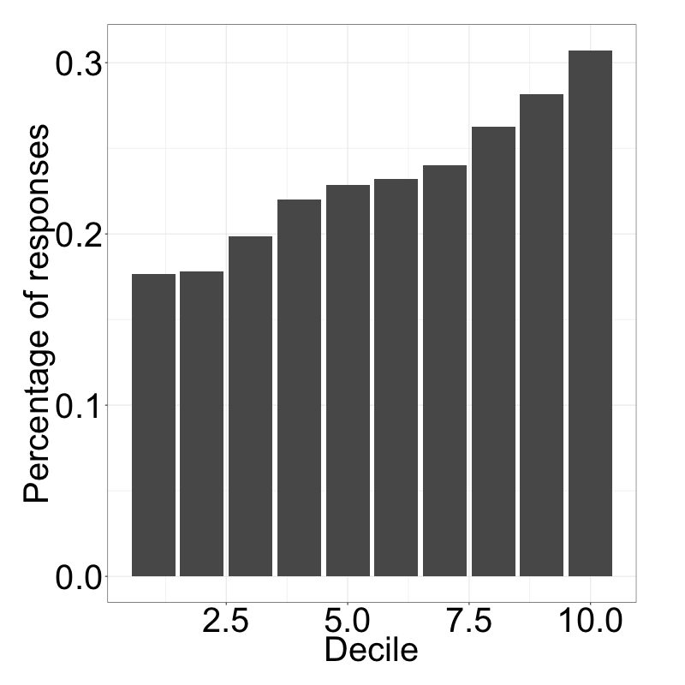
Completeness of observation highly impacts target variable
Incompleteness of sample

Slide 15
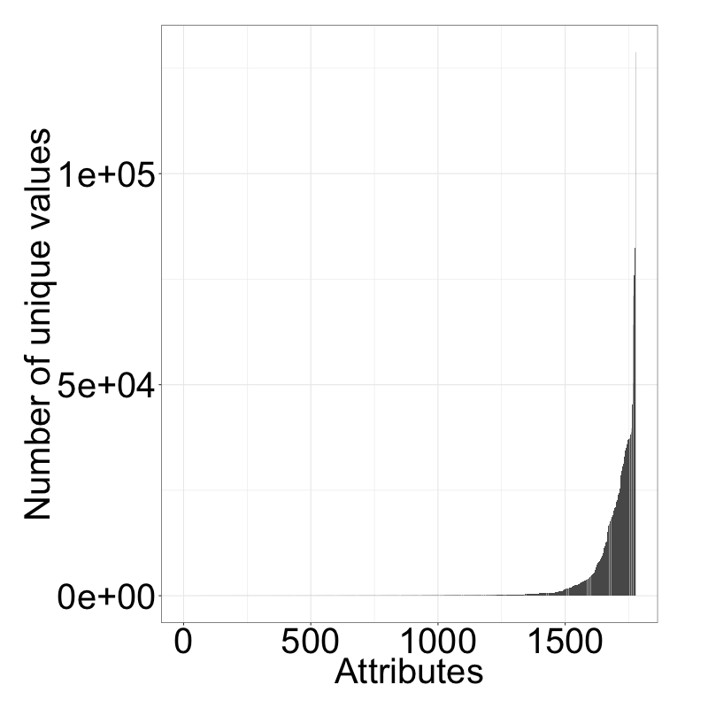
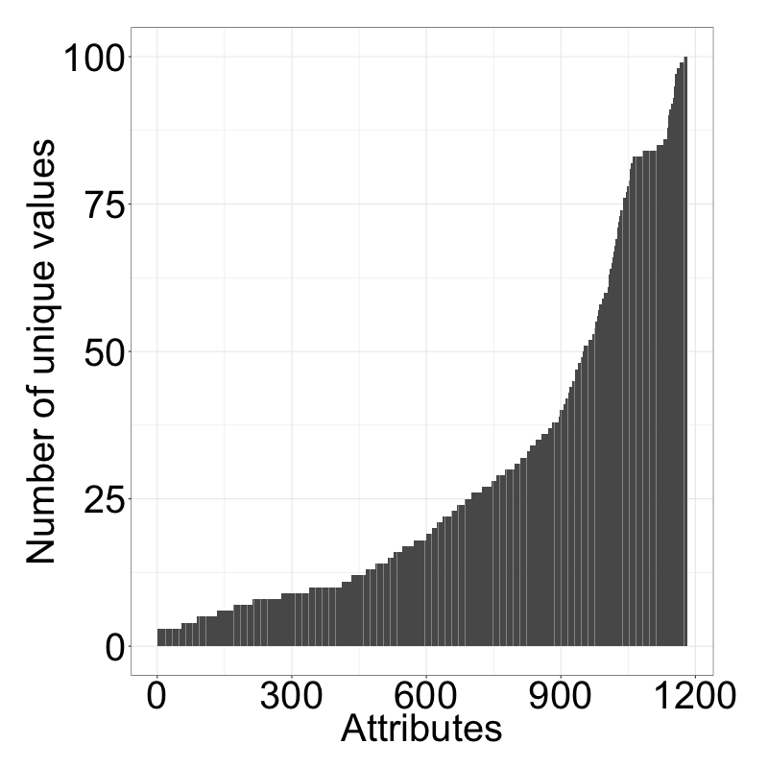
Numerical/categ. values hard to differentiate via “elbow-criterion”
Number of unique values per attribute
Number of unique values (<101)

Slide 16
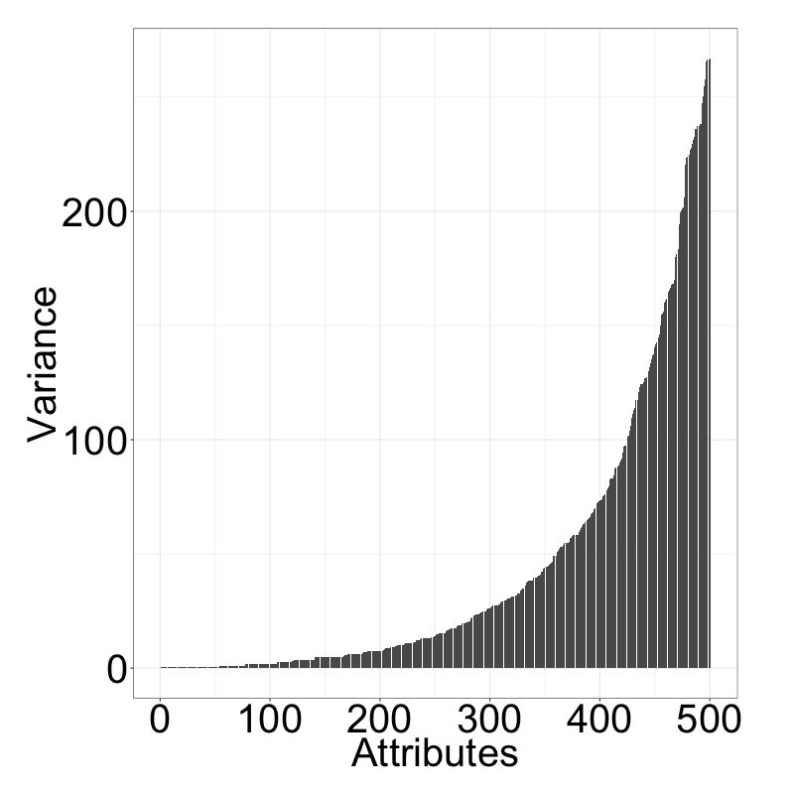
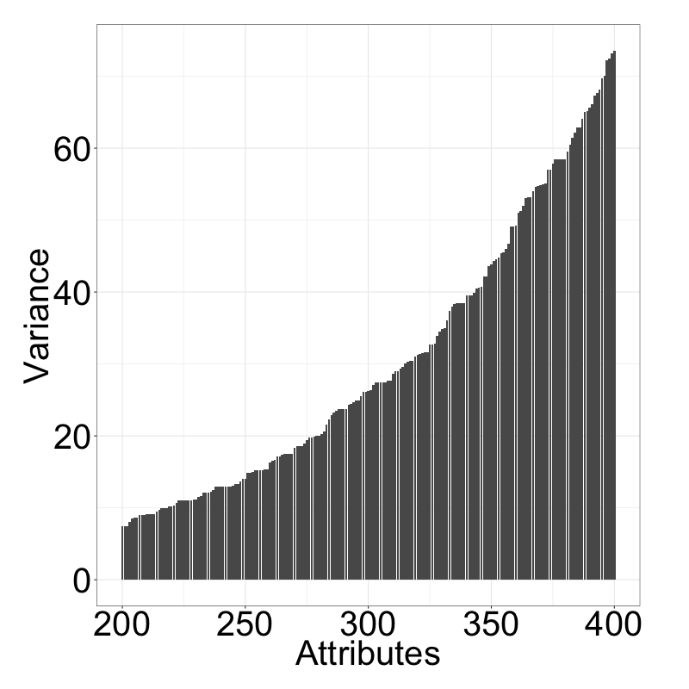
Elbow criterion applied to variances of unique values more insightful?
Var. between unique values (lowest 500)¹
Var. between unique values (200-400)
Elbows?
Elbow?
Highest difference between the 357. and the 358. attribute. We therefore assume, that the attributes 1-357 (sorted by variance) are candidates for categorical attributes.
1) Where the number of unique values is less than 101

Slide 17
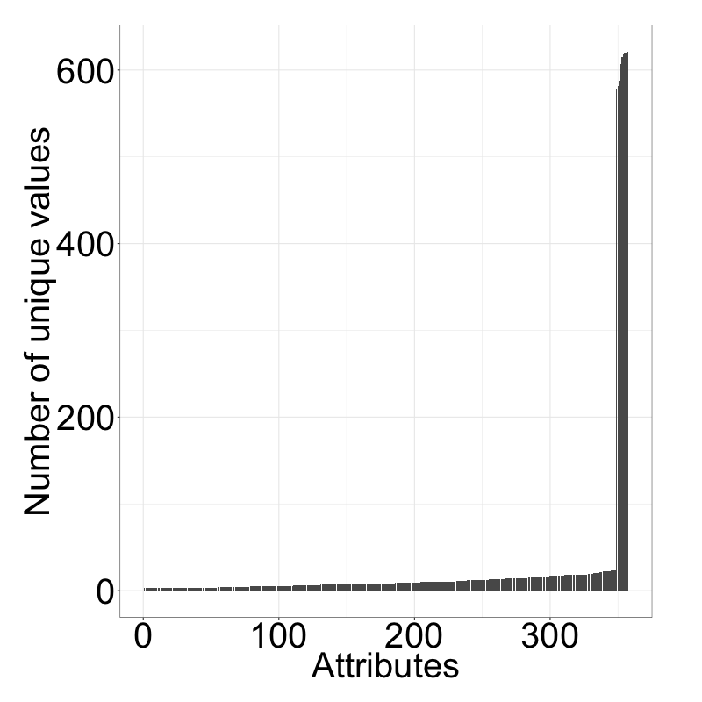
Reapplying this to the number of unique values reveals drastic elbow
Number of unique values per attribute
Highest gap between 348 and 349, it seems reasonable that out of the 348 attributes with the lowest variances, the attributes with the lowest number of unique values are categorical. All these attributes have less than 23 unique values.
Elbow
We identified 348 attributes, that are likely to be categorical. This is just a rough estimate, however, as the meaning of attributes is unknown.

Slide 18
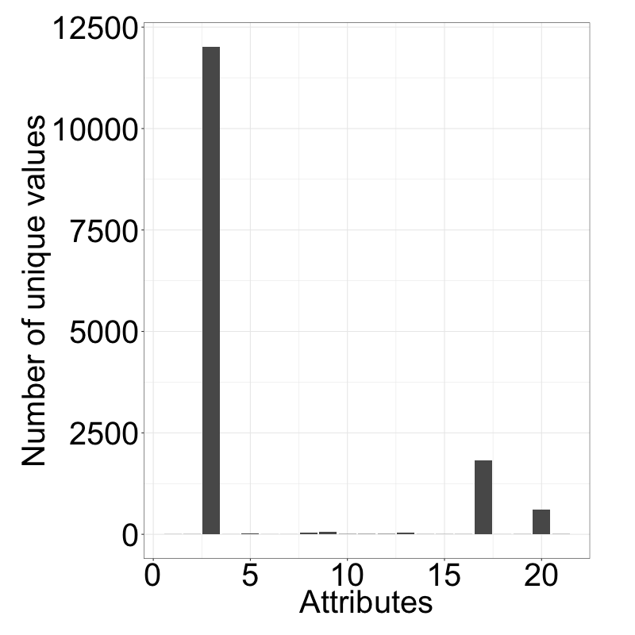
Number of unique values for strings differs greatly
Number of unique values per attribute
Too detailed, high chance of overfitting (and already included in US states)
Cities
Too detailed, high chance of overfitting)
US states
Job descriptions
99.99% NA values
We identified 348 attributes, that are likely to be categorical. This is just a rough estimate, however, as the meaning of attributes is unknown.

Slide 19
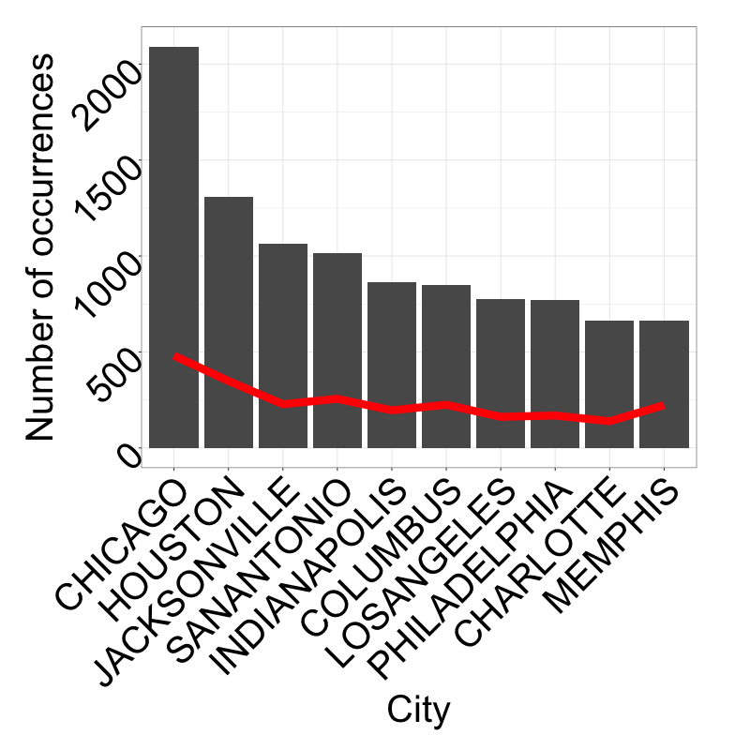
No city really stands out in terms of total occurrences

Slide 20
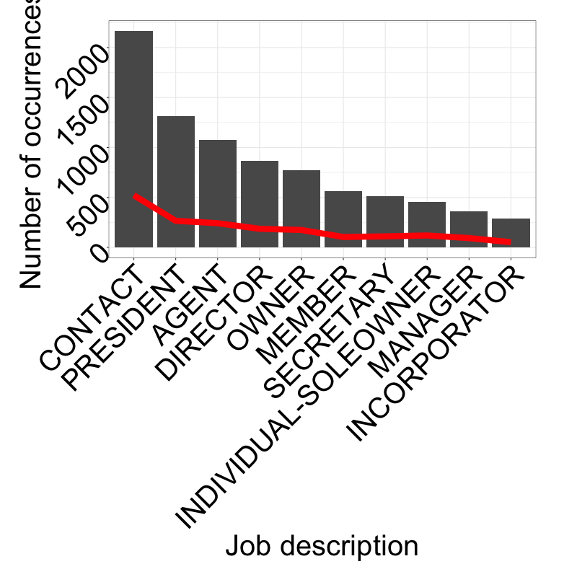
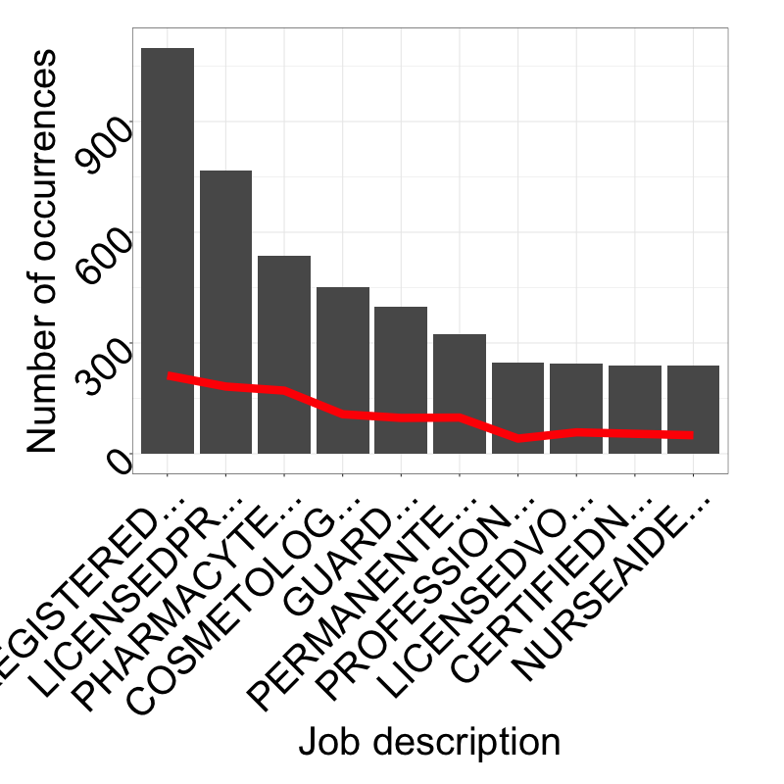
No Job description really stands out in terms of total occurrences

Slide 21
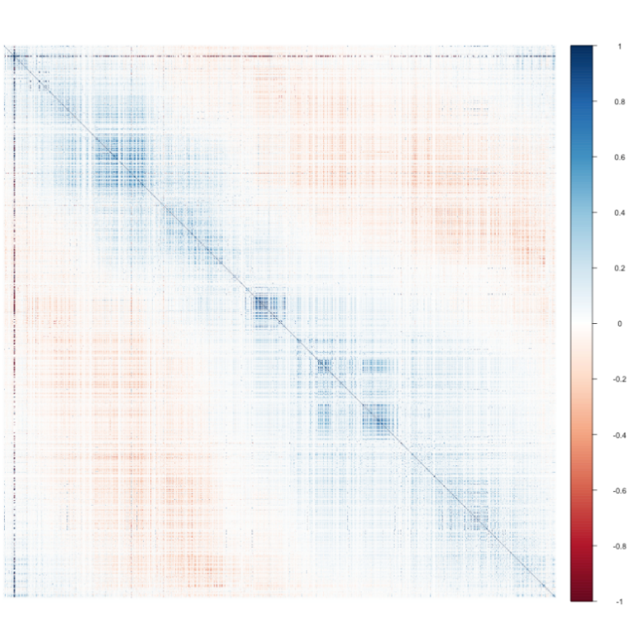
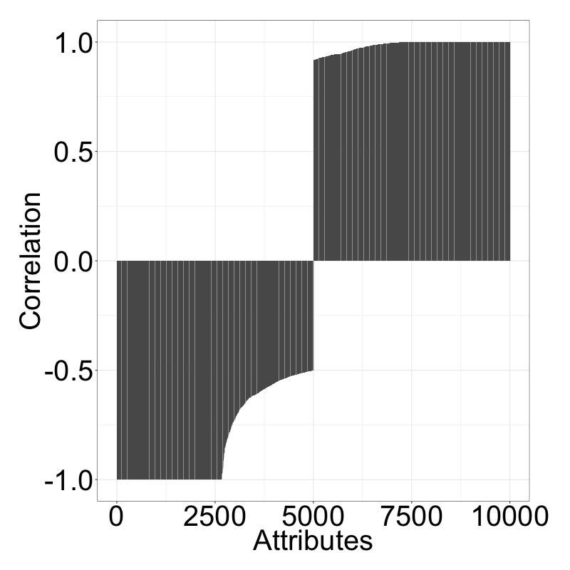
Attributes are fairly uncorrelated according to pearson coef.
Correlations between all attributes
5000 lowest and highest correlations

Slide 22
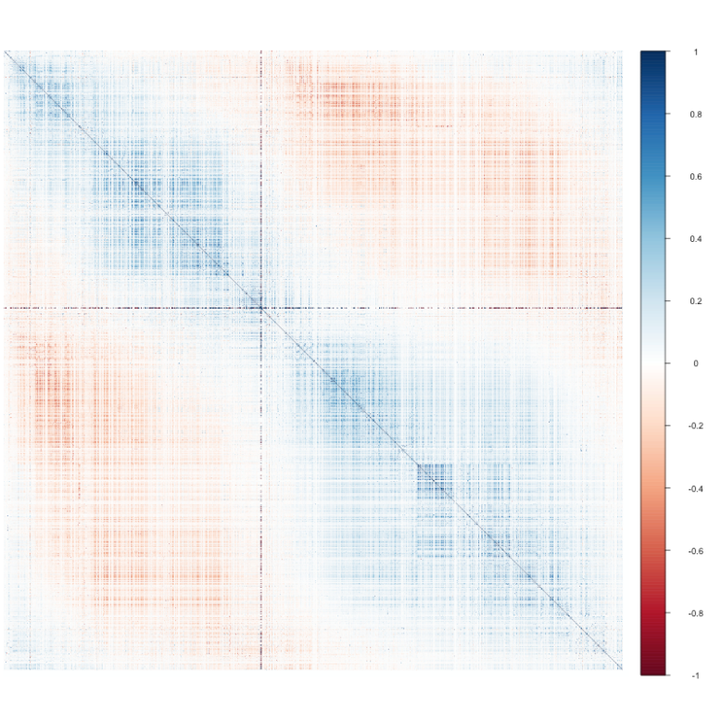
Spearman reveals higher correlation according to rank of att. values
Correlations between all attributes
5000 lowest and highest correlations
45 entries with a correlation of 1 and 13 entries with a correlation of -1 could be identified (out of these 49 unique attributes). We can therefore remove these 49 attributes.

Slide 23
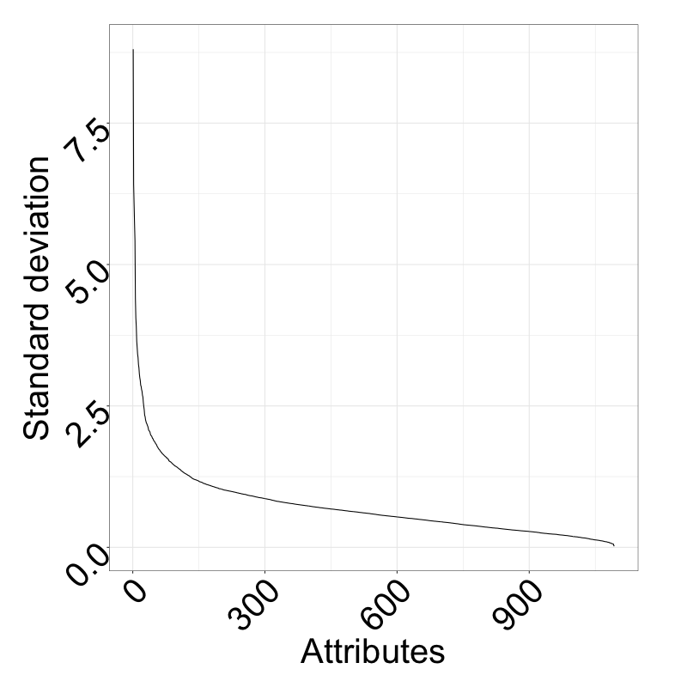
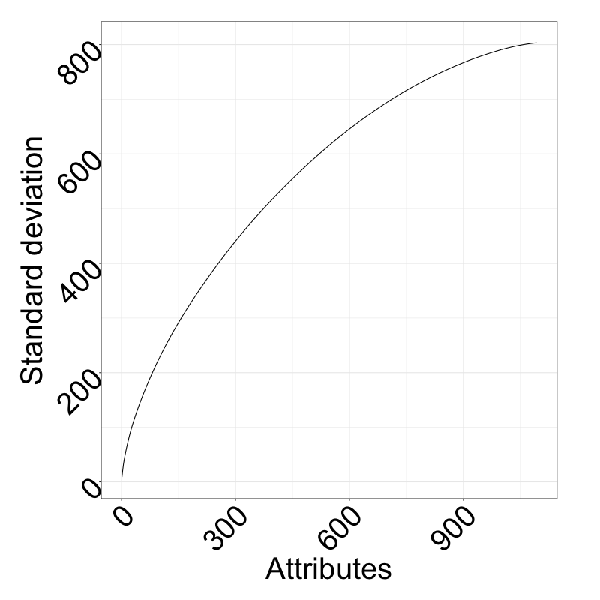
PCA reveals steep curve; however, no distinct elbow can be identified
Explained variance by PCs
Cumsum of variance of PCs
The first 600 PCs explain more than 80% of the variance; decreasing the dimensionality might be utilized for performance improvements.

Slide 24
Agenda
Data understanding
Data cleaning
Machine learning approaches
Results

Slide 25
Publications on big data
45 entries with a correlation of 1 and 13 entries with a correlation of -1 could be identified (out of these 49 unique attributes). We can therefore remove these 49 attributes.

Slide 27
References
Hansen, C. H., & Sehrndt, C. H. (2001). Fundamentals of acoustics. Occupational Exposure to Noise: Evaluation, Prevention and Control. World Health Organization.
http://cmc.music.columbia.edu/musicandcomputers/, last visited 21.10.2016
James, J. F. (2011). A student's guide to Fourier transforms: with applications in physics and engineering. Cambridge university press.
http://www.di.fc.ul.pt/~jpn/r/fourier/fourier.html, last visited 21.10.2016
http://www.abstractnew.com/2014/04/the-fast-fourier-transform-fft-without.html, last visited 21.10.2016
Robinson, D. W., & Dadson, R. S. (1956). A re-determination of the equal-loudness relations for pure tones. British Journal of Applied Physics, 7(5), 166.
http://www.diracdelta.co.uk/science/source/e/q/equal%20loudness%20contour/source.html#.WADCgpN940p, last visited 21.10.2016
https://developer.spotify.com/web-api/get-audio-features/, last visited 21.10.2016
Peeters, G. (2004). A large set of audio features for sound description (similarity and classification) in the CUIDADO project
https://www.dsprelated.com/showcode/174.php, last visited 21.10.2016
http://nlp.stanford.edu/sentiment/, last visited 21.10.2016
Pandya, R., & Pathak, K. (2014). Survey on Noise Estimation and Removal Methods through SVM. International Journal of Computer Applications, 86(9).
Kamruzzaman, S. M., Karim, A. N. M., Islam, M., & Haque, M. (2010). Speaker identification using mfcc-domain support vector machine. arXiv preprint arXiv:1009.4972.

Slide 28





Some practical application fields
Speech
Nature sound
Sentiment analysis¹
Voice classification²
Automatic speaker recognition³
Speech to text systems⁴
Machine failure recognition⁶
Military sound analysis⁶
Animal sound recog-nition (e.g. birds)⁷
Music signal processing
Other
Genre identification⁵
Instrumentation⁵
Dynamics, tempo and timbre⁵
Medical hearing aid⁶
Adaptive noise cancelling⁶
Digital watermarking⁶
Source: 1) http://nlp.stanford.edu/sentiment/, 2) Pandya, Pathak (2014), 3) Kamruzzaman et al. (2010), 4) https://research.googleblog.com/2015/08/the-neural-networks-behind-google-voice.html,
5) http://signalprocessingsociety.org/uploads/special_issues_deadlines/MusicSP.pdf,
6) Perez-Meana (2007), 7) Stowell, Plumbley (2014)

Slide 29
References
https://research.googleblog.com/2015/08/the-neural-networks-behind-google-voice.html, last visited 21.10.2016
http://signalprocessingsociety.org/uploads/special_issues_deadlines/MusicSP.pdf, last visited 21.10.2016
Perez-Meana, H. (Ed.). (2007). Advances in Audio and Speech Signal Processing: Technologies and Applications: Technologies and Applications. Igi Global.
Stowell, D., & Plumbley, M. D. (2014). Automatic large-scale classification of bird sounds is strongly improved by unsupervised feature learning. PeerJ, 2, e488.
Wang, A. (2003, October). An Industrial Strength Audio Search Algorithm. InISMIR (pp. 7-13).

